Slide 1
Recursion and Sorting
Prepared by: Afaq Mansoor Khan
BSSE III- Group A
Session 2017-21
IMSciences, Peshawar.

Slide 2
Last Lecture Summary
Overview of Search Algorithms
Algorithm Analysis
Time and Space Complexity
Big O Notation
Introduction of Linear Searching
Introduction to Binary Search,
Comparison of Linear and Binary Search

Slide 3
Objectives Overview
Recursion and Types, Space and Time Complexity
Introduction to Sorting Algorithms
Bubble Sort Algorithm, Algorithm Analysis

Slide 4
Recursion
It is the process of repeating items in a self-similar way.
For instance, when the surfaces of two mirrors are exactly parallel with each other the nested images that occur are a form of infinite recursion.
The term recursion has a variety of meanings specific to a variety of disciplines ranging from linguistics to logic.

Slide 5
Recursion - Concept
In computer science, a class of objects or methods exhibit recursive behavior when they can be defined by two properties:
A simple base case (or cases), and
A set of rules which reduce all other cases toward the base case.
For example, the following is a recursive definition of a person's ancestors:
One's parents are one's ancestors (base case).
The parents of one's ancestors are also one's ancestors (recursion step).
Many mathematical axioms are based upon recursive rules.
e.g. the formal definition of the natural numbers in set theory follows: 1 is a natural number, and each natural number has a successor, which is also a natural number.
By this base case and recursive rule, one can generate the set of all natural numbers

Slide 6
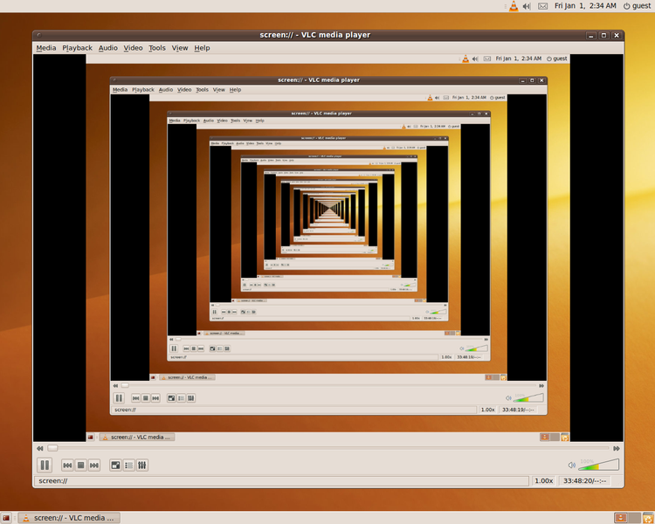
Recursion - Concept
Recursion in a screen recording program, where the smaller window contains a snapshot of the entire screen.

Slide 7
Recursive Algorithms
A common computer programming tactic is
to divide a problem into sub-problems of the same type as the original,
solve those problems, and combine the results
This is often referred to as the divide-and-conquer method
When combined with a lookup table that stores the results of solving sub-problems
(to avoid solving them repeatedly and incurring extra computation time)
It can be referred to as dynamic programming

Slide 8
Recursive Function
A recursive function definition has one or more base cases
meaning input(s) for which the function produces a result trivially (without recurring), and
one or more recursive cases, meaning input(s) for which the program recurs (calls itself).
For example, the factorial function can be defined recursively by the equations 0! = 1
and, for all n >0; n! = n(n-1)!
Neither equation by itself constitutes a complete definition;
First is the base case, and
Second is the recursive case.

Slide 9
Recursive Function
The job of the recursive cases can be seen as breaking down complex inputs into simpler ones
In a properly designed recursive function, with each recursive call, the input problem must be simplified in such a way that eventually the base case must be reached.
Neglecting to write a base case, or testing for it incorrectly, can cause an infinite loop

Slide 10
Recursion
Recursive functions
Function that calls itself
Can only solve a base case
Divides up problem into
What it can do
What it cannot do - resembles original problem
Launches a new copy of itself (recursion step)
Eventually base case gets solved
Gets plugged in, works its way up and solves whole problem

Slide 11
Recursion – Example
Example: factorial:
5! = 5 * 4 * 3 * 2 * 1
Notice that 5! = 5 * 4! 4! = 4 * 3! ...
Can compute factorials recursively
Solve base case (1! = 0! = 1) then plug in
2! = 2 * 1! = 2 * 1 = 2;
3! = 3 * 2! = 3 * 2 = 6;
unsigned int factorial(unsigned int n) {
if (n <= 1)
return 1;
else
return n * factorial(n-1); }

Slide 12
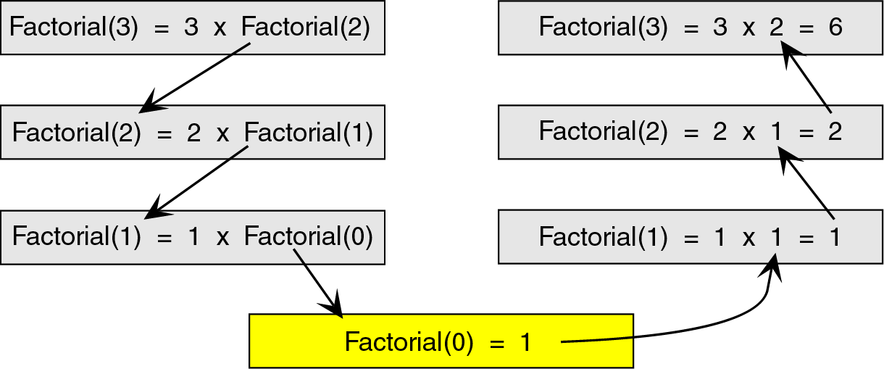
Factorial Trace
To see how the recursion works, let’s break down the factorial function to solve factorial(3)

Slide 13
Recursion – Fibonacci Series
Fibonacci series: 0, 1, 1, 2, 3, 5, 8, 13, 21, 34, 55, 89, ...
Each number sum of the previous two
fib(n) = fib(n-1) + fib(n-2) - recursive formula
long fibonacci(long n)
{
if (n==0 || n==1) //base case
return n;
else return fibonacci(n-1)+fibonacci(n-2);
}

Slide 14
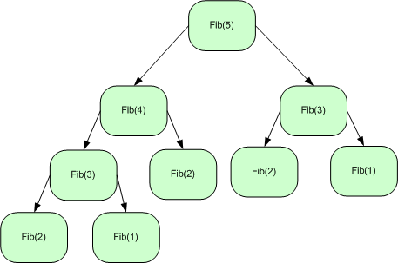
Recursive Fibonacci Series

Slide 15
Recursion : Fibonacci Series
f( 3 )
return
f( 2 )
+
f( 1 )
return
f( 1 )
+
f( 0 )
return 1
return 1
return 0

Slide 16
Terminating Condition
The recursive functions always contains one or more terminating conditions.
A condition when a recursive function is processing a simple case instead of processing recursion.
Without the terminating condition, the recursive function may run forever.
e.g., in the previous multiply function, the if statement “if (n == 1) …” is the terminating condition.

Slide 17
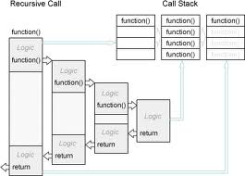
Recursion – Memory Map

Slide 18
Linear Search - Recursive
Linear search can also be described as a recursive algorithm:
LinearSearch(list, size, key)
if the list is empty, return Λ;
else
if the first item of the list has the desired value, return its location;
else
return LinearSearch(value, remainder of the list)

Slide 19
Linear Search – Recursive Code
int linearSearch(const int list[], int first, int last, int key)
{
if (first == last) // base case: target not found
return last;
if (list[first] == target) // base case: target found return first;
// inductive step: search with range [first+1, last)
return RecLinearSearch (arr, first+1, last, target)
} // end RecLinearSearch

Slide 20
Binary Search W & W/O Recursion
int first, last, upper;
first = 0;
last = size - 1;
while (true) {
middle = (first + last) / 2;
if (data[middle] == value)
return middle;
else if (first >= last)
return -1;
else if (value < data[middle])
last = middle - 1;
else
first = middle + 1;
}
}
{ int middle = (first + last) / 2;
if (data[middle] == value)
return middle;
else if (first >= last)
return -1;
else if (value < data[middle])
return bsearchr(data, first, middle-1, value);
else
return bsearchr(data, middle+1, last, value);
}
w/o recursion
with recursion

Slide 21
Recursion - Comments
Recursion is never "necessary"
Anything that can be done recursively, can be done iteratively
Recursive solution may seem more logical
For example, printing the list - the iterative solution given is very awkward, and does not model the human way of doing the problem, if given a list
The recursive solution did not use any nested loops, while the iterative solution did
However, the recursive solution made many more function calls, which adds a lot of overhead
Recursion is NOT an efficiency tool - use it only when it helps the logical flow of your program

Slide 22
Recursion
PROS
Clearer logic
Often more compact code
Often easier to modify
Allows for complete analysis of runtime performance
CONS
Overhead costs

Slide 23
Recursion Vs. Iteration
Repetition
Iteration: explicit loop
Recursion: repeated function calls
Termination
Iteration: loop condition fails
Recursion: base case recognized
Both can have infinite loops
Balance
Choice between performance (iteration) and good software engineering (recursion)
Recursion
Main advantage is usually simplicity
Main disadvantage is often that the algorithm may require large amounts of memory if the depth of the recursion is very large

Slide 24
Recursion vs. Iteration
Some simple recursive problems can be “unwound” into loops
But code becomes less compact, harder to follow!
Hard problems cannot easily be expressed in non-recursive code
Robots or avatars that “learn”
Advanced games

Slide 25
Recursion - Overhead
Space: Every invocation of a function call may require space for parameters and local variables, and for an indication of where to return when the function is finished
Typically this space (allocation record) is allocated on the stack and is released automatically when the function returns. Thus, a recursive algorithm may need space proportional to the number of nested calls to the same function.

Slide 26
Recursion - Overhead
Time: The operations involved in calling a function - allocating, and later releasing, local memory, copying values into the local memory for the parameters, branching to/returning from the function - all contribute to the time overhead.
If a function has very large local memory requirements, it would be very costly to program it recursively. But even if there is very little overhead in a single function call, recursive functions often call themselves many many times, which can magnify a small individual overhead into a very large cumulative overhead

Slide 27
Recursion - Overhead
We have to pay a price for recursion:
calling a function consumes more time and memory than adjusting a loop counter.
high performance applications (graphic action games, simulations of nuclear explosions) hardly ever use recursion.
In less demanding applications recursion is an attractive alternative for iteration (for the right problems!)

Slide 28
Recursion – Final comments
For every recursive algorithm, there is an equivalent iterative algorithm.
Recursive algorithms are often shorter, more elegant, and easier to understand than their iterative counterparts.
However, iterative algorithms are usually more efficient in their use of space and time.
28

Slide 29
Sorting

Slide 30
Sorting
A fundamental operation in computer science
Task of rearranging data in an order such as
Ascending
Descending
Lexicographic
Data may be of any type like numeric, alphabetical or alphanumeric
It also refers to rearranging a set of records based on their key values when the records are stored in a file
Sorting task arises more frequently in the world of data manipulation
30

Slide 31
Sorting
Sorting and searching frequently apply to a file of records
Each record in a file F can contain many fields but there may be one particular field whose values uniquely determine the records in the file called primary key
The key or key values are k1, k2, ……
Sorting the file F usually refers to sorting F with respect to a particular primary key
Searching in F refers to searching for a record with a given key value
31

Slide 32
Sorting
Let A be a list of n elements in memory
A₁, A₂, ……., A_{n}
Sorting refers to the operations of rearranging the contents of A so that they are increasing in order numerically or lexicographically so that
A₁ ≤ A₂ ≤ A₃ ≤ …………..≤ A_{n}
Since A has n elements, there are n! ways that contents can appear in A
These ways correspond precisely to the n! permutations of 1, 2, …., n
Accordingly each sorting algorithms must take care of these n! possibilities
32

Slide 33
Basic Terminology
Internal sort
When a set of data to be sorted is small enough such that the entire sorting can be performed in a computer’s internal storage (primary memory)
External sort
Sorting a large set of data which is stored in low speed computer’s external memory such as hard disk, magnetic tape, etc.
Ascending order
An arrangement of data if it satisfies “less than or equal to <=“ relation between two consecutive data
[1, 2, 3, 4, 5, 6, 7, 8, 9]

Slide 34
Basic Terminology
Descending order
An arrangement of data if it satisfies “greater than or equal to >=“ relation between two consecutive data
e.g. [ 9, 8, 7, 6, 5, 4, 3, 2, 1]
Lexicographic order
If the data are in the form of character or string of characters and are arranged in the same order as in dictionary
e.g. [ada, bat, cat, mat, max, may, min]
Collating sequence
Ordering for a set of characters that determines whether a character is in higher, lower or same order compared to another
e.g. alphanumeric characters are compared according to their ASCII code
e.g. [AmaZon, amaZon, amazon, amazon1, amazon2]

Slide 35
Basic Terminology
Random order
If a data in a list do not follow any ordering mentioned above, then it is arranged in random order
e.g. [8, 6, 5, 9, 3, 1, 4, 7, 2]
[may, bat, ada, cat, mat, max, min]
Swap
Swap between two data storages implies the interchange of their contents.
e.g. Before swap A[1] = 11, A[5] = 99
After swap A[1] = 99, A[5] = 11
Item
Is a data or element in the list to be sorted.
May be an integer, string of characters, a record etc.
Also alternatively termed key, data, element etc.

Slide 36
Basic Terminology
Stable Sort
A list of data may contain two or more equal data. If a sorting method maintains the same relative position of their occurrences in the sorted list then it is stable sort
e.g. [ 2, 5, 6, 4, 3, 2, 5, 1, 5 ]
[ 1, 2, 2, 3, 4, 5, 5, 5, 6 ]
In Place Sort
Suppose a set of data to be sorted is stored in an array A
If a sorting method takes place within the array A only, i.e. without using any other extra storage space
It is a memory efficient sorting method

Slide 37
Stability
Stable sorting algorithms maintain the relative order of records with equal keys.
A key is that portion of record which is the basis for the sort
it may or may not include all of the record
If all keys are different then this distinction is not necessary.
But if there are equal keys, then a sorting algorithm is stable if whenever there are two records (let's say R and S) with the same key, and R appears before S in the original list, then R will always appear before S in the sorted list.

Slide 38
Stability
When equal elements are indistinguishable, such as with integers, or more generally, any data where the entire element is the key, stability is not an issue.
However, assume that the following pairs of numbers are to be sorted by their first component:
(4, 2) (3, 7) (3, 1) (5, 6)
Two different results are possible,
one which maintains the relative order of records with equal keys, and one which does not:
(3, 7) (3, 1) (4, 2) (5, 6) (order maintained)
(3, 1) (3, 7) (4, 2) (5, 6) (order changed)

Slide 39
Sorting Methods
Bubble Sort Heap Sort
Selection Sort Merge Sort
Insertion Sort Quick Sort

Slide 40
Bubble Sort

Slide 41
Bubble Sort
Sometimes incorrectly referred to as sinking sort, is a simple sorting algorithm that works by repeatedly stepping through the list to be sorted, comparing each pair of adjacent items and swapping them if they are in the wrong order.
The pass through the list is repeated until no swaps are needed, which indicates that the list is sorted.
The algorithm gets its name from the way smaller elements "bubble" to the top of the list.
Because it only uses comparisons to operate on elements, it is a comparison sort.

Slide 42
Bubble Sort
Bubble sort is a simple sorting algorithm
The algorithm starts at the beginning of the data set.
It compares the first two elements, and if the first is greater than the second, it swaps them.
It continues doing this for each pair of adjacent elements to the end of the data set.
It then starts again with the first two elements, repeating until no swaps have occurred on the last pass.
Note that the largest end gets sorted first, with smaller elements taking longer to move to their correct positions.

Slide 43
Bubble Sort Algorithm
The Bubble Sort algorithm looks at pairs of entries in the array, and swaps their order if needed.
[0] [1] [2] [3] [4] [5]

Slide 44
Bubble Sort Algorithm
The Bubble Sort algorithm looks at pairs of entries in the array, and swaps their order if needed.
Swap?
[0] [1] [2] [3] [4] [5]

Slide 45
Bubble Sort Algorithm
The Bubble Sort algorithm looks at pairs of entries in the array, and swaps their order if needed.
Yes!
[0] [1] [2] [3] [4] [5]

Slide 46
Bubble Sort Algorithm
The Bubble Sort algorithm looks at pairs of entries in the array, and swaps their order if needed.
Swap?
[0] [1] [2] [3] [4] [5]

Slide 47
Bubble Sort Algorithm
The Bubble Sort algorithm looks at pairs of entries in the array, and swaps their order if needed.
No.
[0] [1] [2] [3] [4] [5]

Slide 48
Bubble Sort Algorithm
The Bubble Sort algorithm looks at pairs of entries in the array, and swaps their order if needed.
Swap?
[0] [1] [2] [3] [4] [5]

Slide 49
Bubble Sort Algorithm
The Bubble Sort algorithm looks at pairs of entries in the array, and swaps their order if needed.
No.
[0] [1] [2] [3] [4] [5]

Slide 50
Bubble Sort Algorithm
The Bubble Sort algorithm looks at pairs of entries in the array, and swaps their order if needed.
Swap?
[0] [1] [2] [3] [4] [5]

Slide 51
Bubble Sort Algorithm
The Bubble Sort algorithm looks at pairs of entries in the array, and swaps their order if needed.
Yes!
[0] [1] [2] [3] [4] [5]

Slide 52
Bubble Sort Algorithm
The Bubble Sort algorithm looks at pairs of entries in the array, and swaps their order if needed.
Swap?
[0] [1] [2] [3] [4] [5]

Slide 53
Bubble Sort Algorithm
The Bubble Sort algorithm looks at pairs of entries in the array, and swaps their order if needed.
Yes!
[0] [1] [2] [3] [4] [5]

Slide 54
Bubble Sort Algorithm
Repeat.
Swap? No.
[0] [1] [2] [3] [4] [5]

Slide 55
Bubble Sort Algorithm
Repeat.
Swap? No.
[0] [1] [2] [3] [4] [5]

Slide 56
Bubble Sort Algorithm
Repeat.
Swap? Yes.
[0] [1] [2] [3] [4] [5]

Slide 57
Bubble Sort Algorithm
Repeat.
Swap? Yes.
[0] [1] [2] [3] [4] [5]

Slide 58
Bubble Sort Algorithm
Repeat.
Swap? Yes.
[0] [1] [2] [3] [4] [5]

Slide 59
Bubble Sort Algorithm
Repeat.
Swap? Yes.
[0] [1] [2] [3] [4] [5]

Slide 60
Bubble Sort Algorithm
Loop over array n-1 times, swapping pairs of entries as needed.
Swap? No.
[0] [1] [2] [3] [4] [5]

Slide 61
Bubble Sort Algorithm
Loop over array n-1 times, swapping pairs of entries as needed.
Swap? Yes.
[0] [1] [2] [3] [4] [5]

Slide 62
Bubble Sort Algorithm
Loop over array n-1 times, swapping pairs of entries as needed.
Swap? Yes.
[0] [1] [2] [3] [4] [5]

Slide 63
Bubble Sort Algorithm
Loop over array n-1 times, swapping pairs of entries as needed.
Swap? Yes.
[0] [1] [2] [3] [4] [5]

Slide 64
Bubble Sort Algorithm
Loop over array n-1 times, swapping pairs of entries as needed.
Swap? Yes.
[0] [1] [2] [3] [4] [5]

Slide 65
Bubble Sort Algorithm
Continue looping, until done.
Swap? Yes.
[0] [1] [2] [3] [4] [5]

Slide 66
Bubble Sort Algorithm
Continue looping, until done.
Swap? Yes.
[0] [1] [2] [3] [4] [5]

Slide 67
Bubble Sort Algorithm
Continue looping, until done.
Swap? Yes.
[0] [1] [2] [3] [4] [5]

Slide 68
Bubble Sort Algorithm - Result
[0] [1] [2] [3] [4] [5]

Slide 69
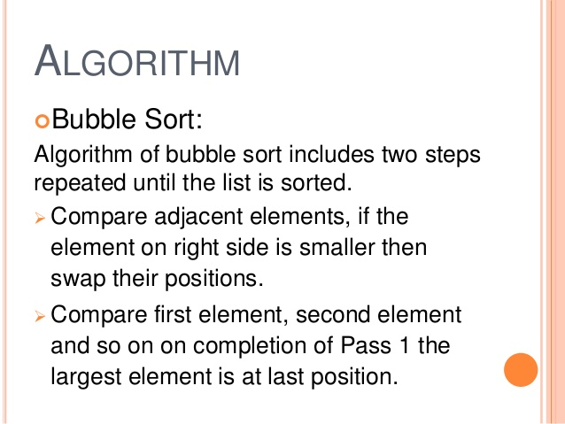

Slide 70
Bubble Sort Implementation
void bubbleSort (int list[ ] , int size) {
int i, j, temp;
for ( i = 0; i < size; i++ ) { /* controls passes through the list */
for ( j = 0; j < size - 1; j++ ) /* performs adjacent comparisons */
{
if ( list[ j ] > list[ j+1 ] ) /* determines if a swap should occur */
{
temp = list[ j ]; /* swap is performed */
list[ j ] = list[ j + 1 ];
list[ j+1 ] = temp;
} // end of if statement
} // end of inner for loop
} // end of outer for loop
} // end of function

Slide 71
Performance
Worst and Average Case Time Complexity: O(n*n). Worst case occurs when array is reverse sorted.
Best Case Time Complexity: O(n). Best case occurs when array is already sorted.
Auxiliary Space: O(1)
Sorting In Place: Yes
Stable: Yes

Slide 72
Summary
Recursion and Types, Space and Time Complexity
Introduction to Sorting Algorithms
Bubble Sort Algorithm, Algorithm Analysis

Slide 73
References
https://www.geeksforgeeks.org/recursion/
https://www.geeksforgeeks.org/sorting-algorithms/
https://brilliant.org/wiki/sorting-algorithms/
https://betterexplained.com/articles/sorting-algorithms/
https://codeburst.io/algorithms-i-searching-and-sorting-algorithms-56497dbaef20

